Slide 1
Cornerstone City Church Peninsula Plus Community Hoo Are Ya
19th November 2023

Slide 2


Slide 3


Slide 4


Slide 5
You Are Good
CCLI Song # 3383788
Israel Houghton
© 2001 Integrity's Praise! Music (Admin. by Integrity Music)
Sound Of The New Breed (Admin. by Integrity Music)
For use solely with the SongSelect® Terms of Use. All rights reserved. www.ccli.com
CCLI Licence No. 33265

Slide 6
1/3
Lord You are good And Your mercy endureth forever Lord You are good And Your mercy endureth forever People from every nation and tongue From generation to generation

Slide 7
2/3
We worship You Hallelujah hallelujah We worship You for who You are We worship You Hallelujah hallelujah We worship You for who You are For You are good

Slide 8
3/3
You are good all the time All the time You are good You are good all the time All the time You are good

Slide 9
There is None Like You G.CcliSongNumber 674545
Lenny LeBlanc
© 1991 Integrity's Hosanna! Music
For use solely with the SongSelect® G.LIT_TermsOfUse. All rights reserved. www.ccli.com
G.CcliLicenseNumber 33265

Slide 10
1/2
There is none like You
No one else can touch
My heart like You do
I could search
For all eternity long and find
There is none like You

Slide 11
2/2
Your mercy flows like a river wide
And healing comes from Your hands
Suffering children are safe in Your arms
There is none like You

Slide 12
Shout To The Lord
CCLI Song # 1406918
Darlene Zschech
© 1993 Wondrous Worship (Admin. by Song Solutions www.songsolutions.org)
For use solely with the SongSelect® Terms of Use. All rights reserved. www.ccli.com
CCLI Licence No. 33265

Slide 13
1/3
My Jesus my Saviour
Lord there is none like You
All of my days I want to praise
The wonders of Your mighty love
My comfort my shelter
Tower of refuge and strength
Let every breath all that I am
Never cease to worship You

Slide 14
2/3
Shout to the Lord
All the earth let us sing
Power and majesty
Praise to the King
Mountains bow down
And the seas will roar
At the sound of Your name

Slide 15
3/3
I sing for joy
At the work of Your hands
Forever I'll love You
Forever I'll stand
Nothing compares to the promise
I have in You

Slide 17
Goodness Of God
CCLI Song # 7117726
Ben Fielding | Brian Johnson | Ed Cash | Jason Ingram | Jenn Johnson
© 2018 Capitol CMG Paragon (Admin. by Capitol CMG Publishing)
Fellow Ships Music (Admin. by Essential Music Publishing LLC)
So Essential Tunes (Admin. by Essential Music Publishing LLC)
SHOUT! Music Publishing Australia (Admin. by SHOUT! Music Publishing UK)
Bethel Music Publishing (Admin. by Song Solutions)
For use solely with the SongSelect® Terms of Use. All rights reserved. www.ccli.com
CCLI Licence No. 33265

Slide 18
1/4
I love You Lord
Oh Your mercy never fails me
All my days
I've been held in Your hands
From the moment that I wake up
Until I lay my head
I will sing of the goodness of God

Slide 19
2/4
All my life You have been faithful
All my life You have been so so good
With every breath that I am able
I will sing of the goodness of God

Slide 20
3/4
I love Your voice
You have led me through the fire
In darkest night
You are close like no other
I've known You as a father
I've known You as a friend
I have lived in the goodness of God

Slide 21
4/4
Your goodness is running after
It’s running after me
Your goodness is running after
It’s running after me
With my life laid down
I’m surrendered now
I give You everything
Your goodness is running after
It's running after me

Slide 23


Slide 24
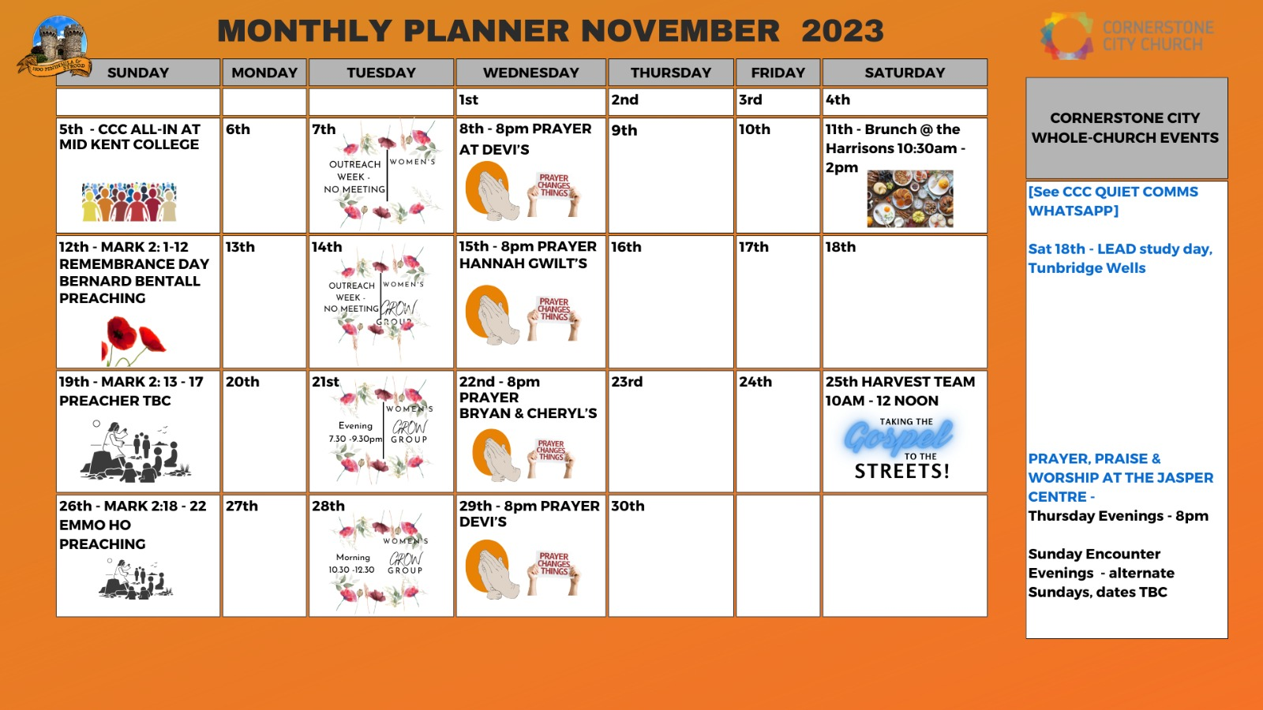

Slide 25


Slide 26
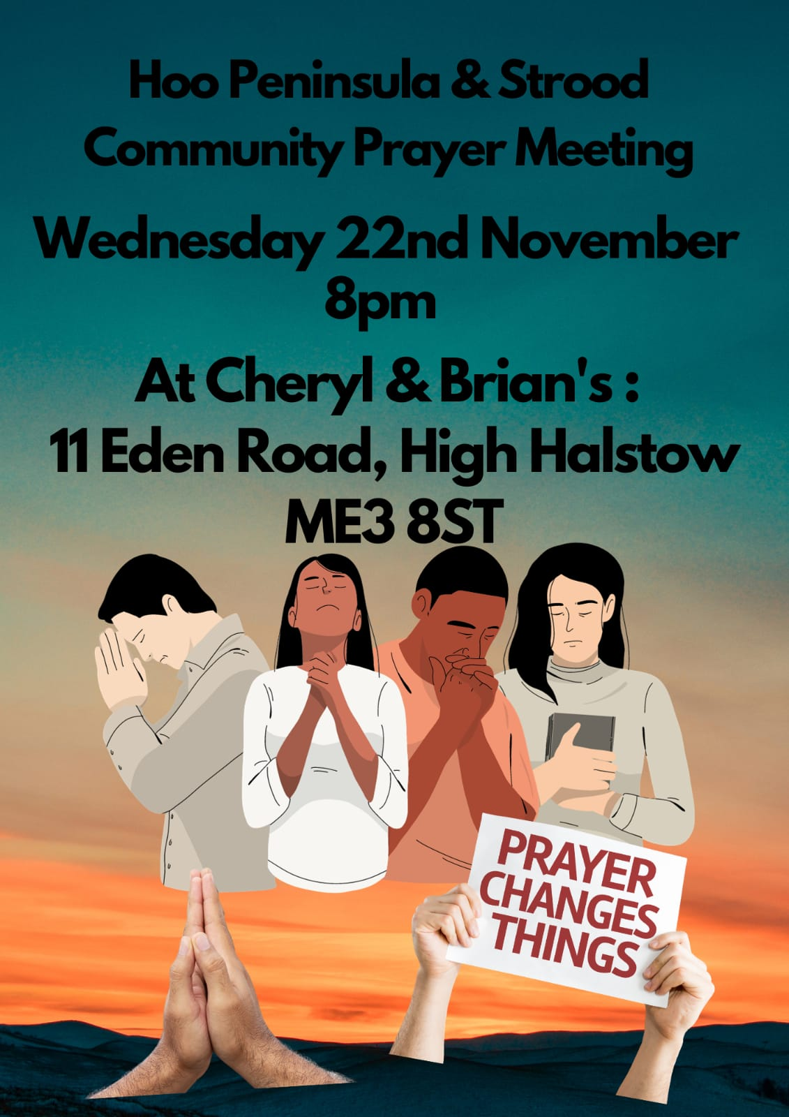

Slide 27


Slide 28
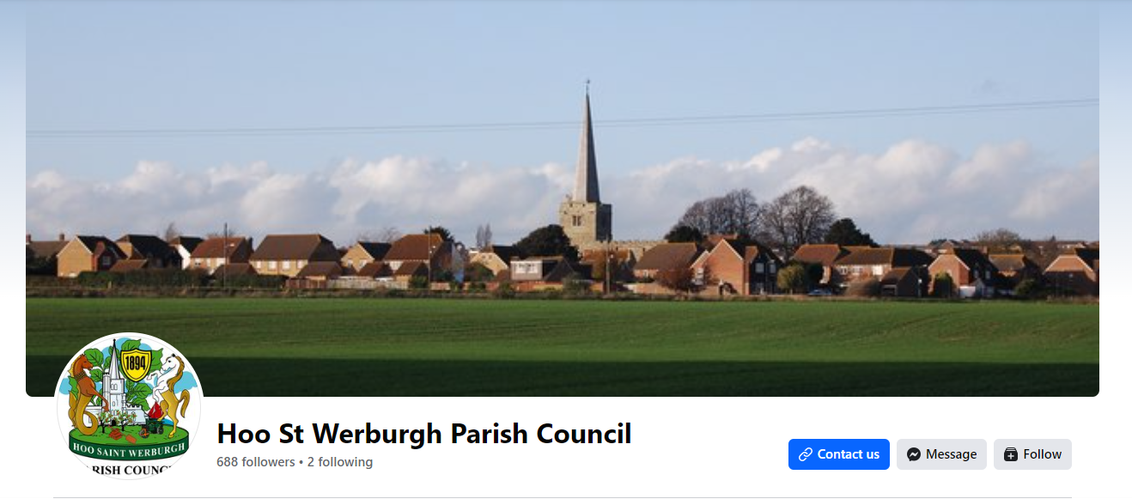
Christmas Celebrationson 8th December in Hoo Square at 6pm
Practice on Monday 4th December at Dele & Florence house. Contact Dele/Florence if you are interested and want to sing in our choir

Slide 29


Slide 30


Slide 31


Slide 32


Slide 33
Oceans (Where Feet May Fail)
G.CcliSongNumber 6428767
Joel Houston | Matt Crocker | Salomon Ligthelm
© 2012 Hillsong Music Publishing Australia
For use solely with the SongSelect® G.LIT_TermsOfUse. All rights reserved. www.ccli.com
G.CcliLicenseNumber 33265

Slide 34
1/4
You call me out upon the waters
The great unknown where feet may fail
And there I find You in the mystery
In oceans deep my faith will stand

Slide 35
2/4
And I will call upon Your name
And keep my eyes above the waves
When oceans rise
My soul will rest in Your embrace
For I am Yours and You are mine

Slide 36
3/4
Your grace abounds in deepest waters
Your sov'reign hand will be my guide
Where feet may fail and fear surrounds me
You've never failed and You won't start now

Slide 37
4/4
Spirit, lead me where my trust is without borders
Let me walk upon the waters
Wherever You would call me
Take me deeper than my feet could ever wander
And my faith will be made stronger
In the presence of my Saviour

Slide 38
2 Corinthians 14 May the grace of the Lord Jesus Christ, and the love of God, and the fellowship of the Holy Spirit be with you all

